Slide 1
Anomaly Detection

Slide 2
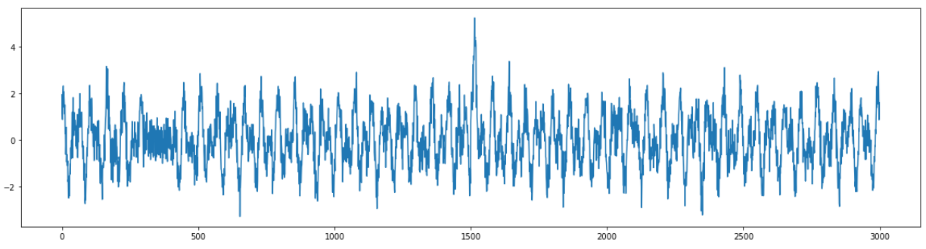
Review - Anomaly Detection
Determines “rare” entities in data
Example: detecting faults in a product line during operation
Unlike classification or regression, anomaly detection models do not need labels to train – they only need the feature data
This task belongs to the Unsupervised Learning branch of Machine Learning
Time | Temperature
555 | 105
556 | 103
557 | 138
558 | 186
559 | 145
560 | 101
561 | 102
563 | 103
Anomaly
No
No
Yes
Yes
Yes
No
No
No
Only needs feature
data to learn
Generated by
trained model

Slide 3
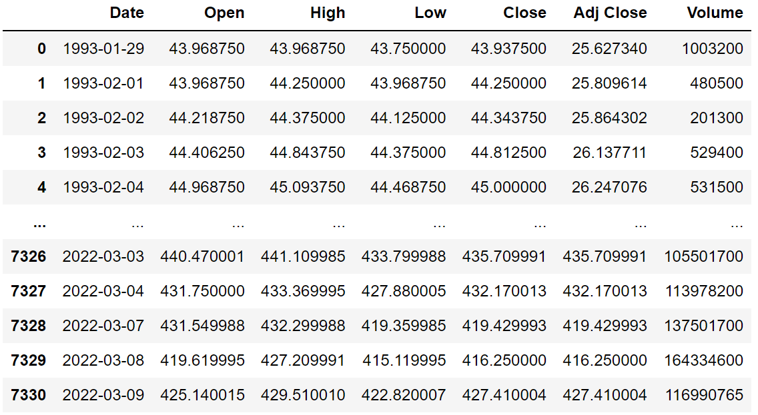
Example: Stock Data
We will be using the SPY ETF for demonstrations of anomaly detection models in this module
The data has about 7300 rows, each representing a day from 1/1993 until 3/2022
Columns are Date, Open, High, Low, Close, Adjusted Close, and Volume
We will be using Open, High, Low, and Close

Slide 4
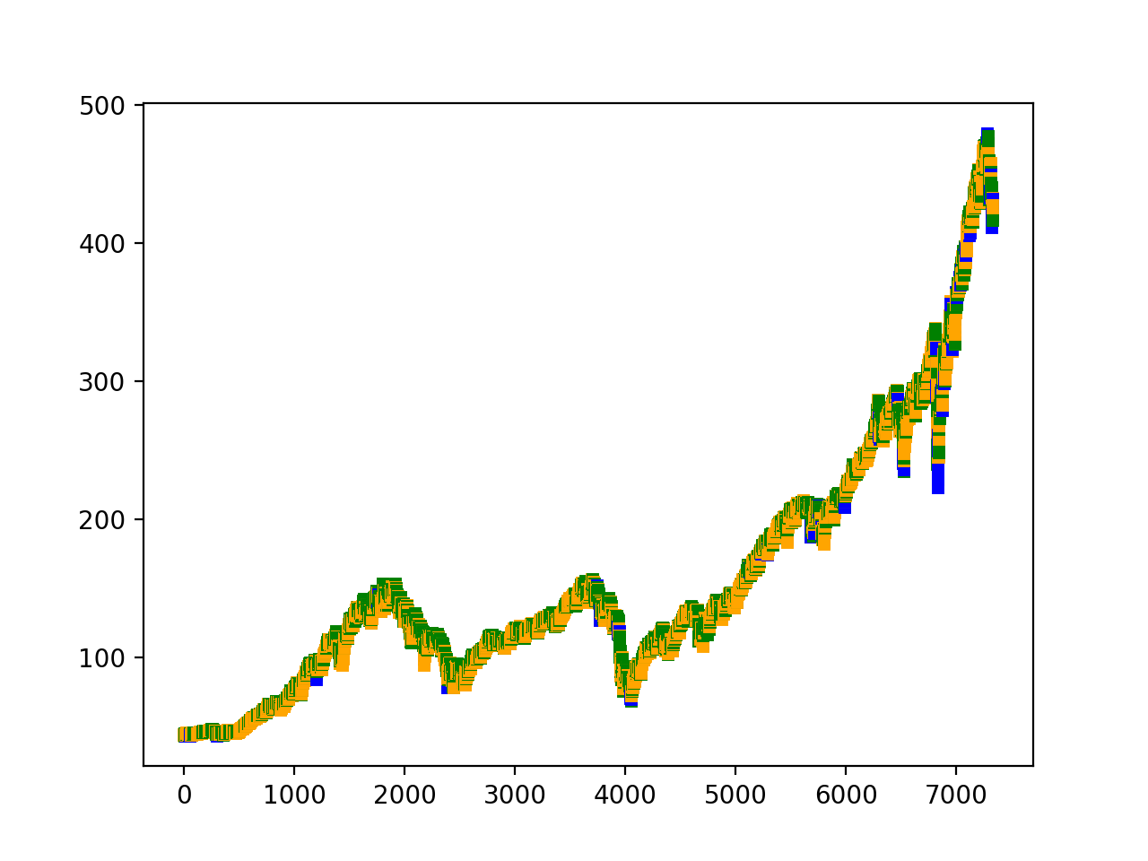
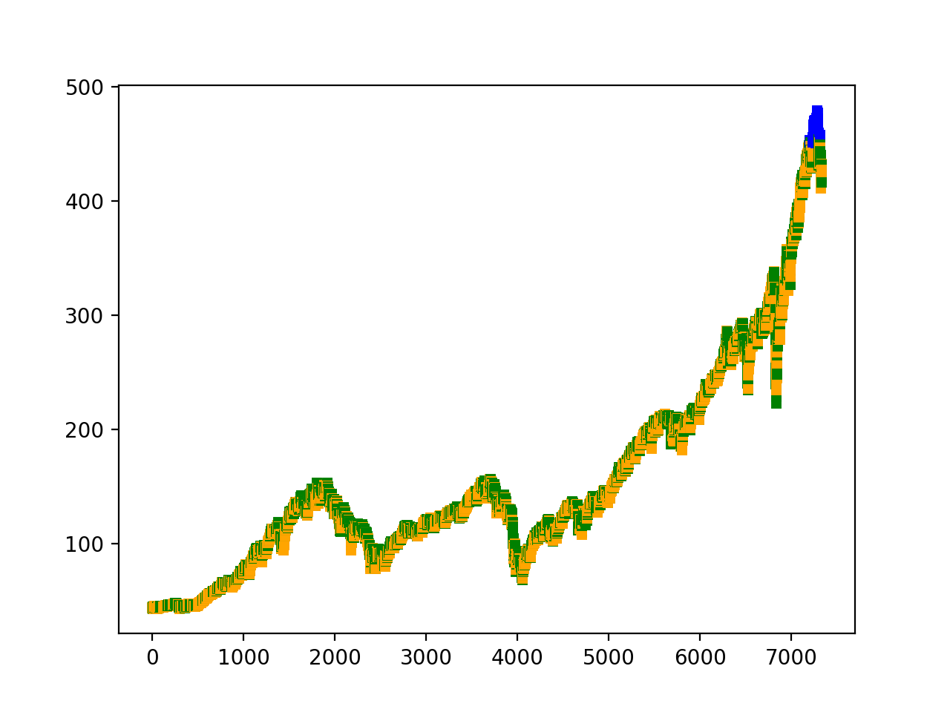

Anomalies in Stock Data
Since we use four features – Open, High, Low, and Close, anomalies are instances (dates) that have irregular distributions these four values
Examples: extreme differences between Open and Close, or between High and Low
Depending on the models use and preprocessing methods, the definition for anomalies might be different
Anomalies (Blue) Detected by One-class SVM, Isolation Forest, and One-class SVM in Processed Data

Slide 5
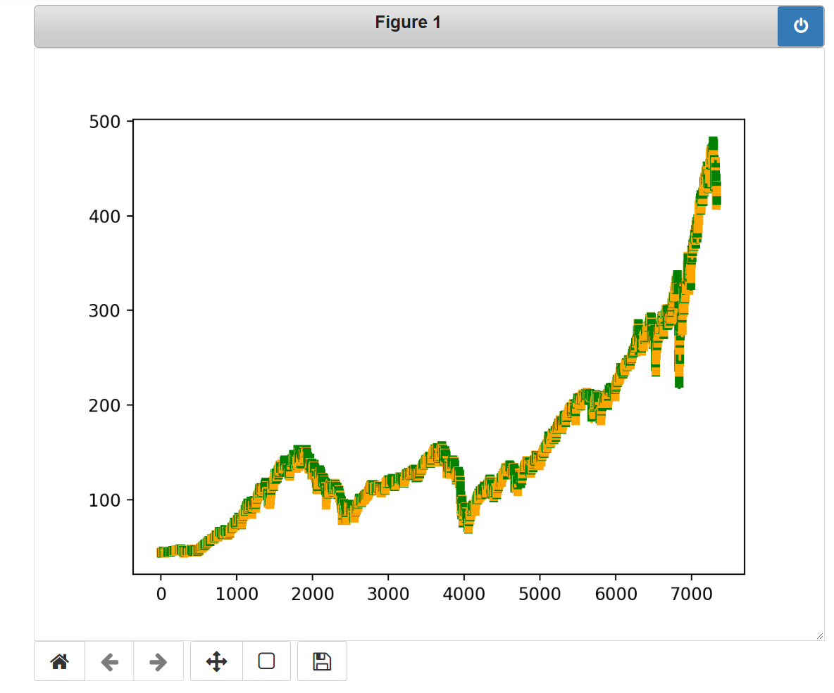
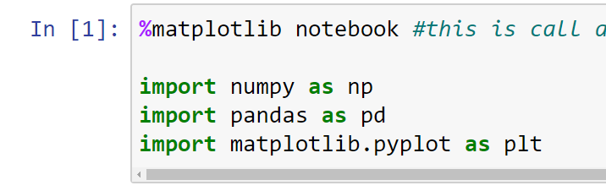
Interactive Figure in Jupyter
Close button – remember to close the figure interaction after you are done with it, otherwise other figures will not show
We can use the %matplotlib notebook command to enable interactive mode for figures
Once enabled, the interactive mode will persist until the end of your Jupyter session
Reset the figure
Zoom in the figure
Move the current view (in zoomed mode)

Slide 6
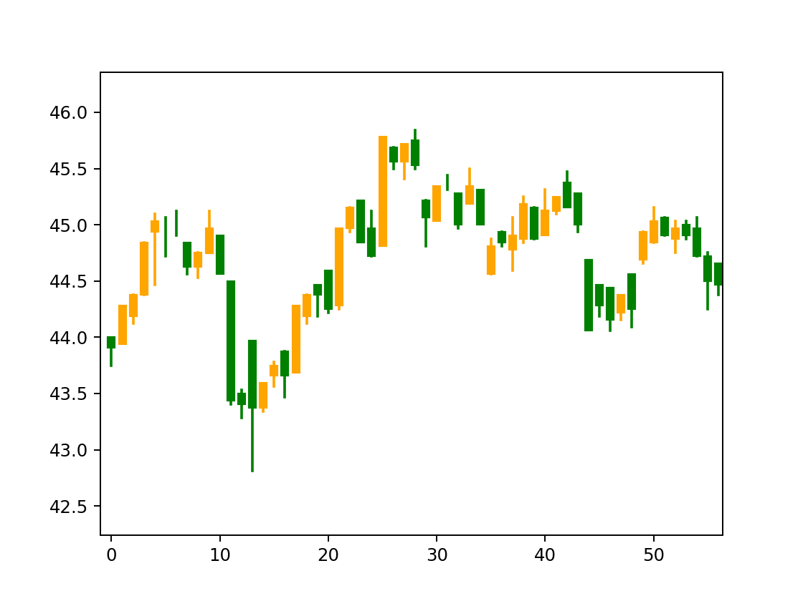
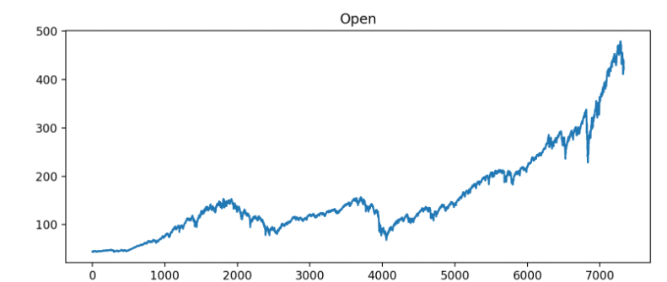
Stock Chart
We will use two types of charts to illustrate the data and anomalies
Time Series Plot
Candlestick Plot

Slide 7
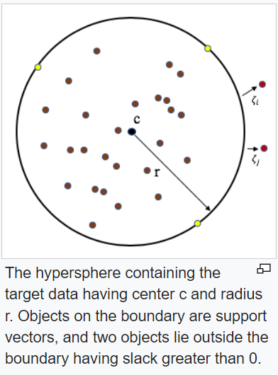
One-Class Support Vector Machine
Fairly similar to the classification and regression SVM, one class SVM fits a boundary on the data to detect anomalies
In this case, the boundary is a hypersphere
Instances inside the hypersphere are “normal”
Instances outside the hypersphere are “anomalous”
The hypersphere is fit such that it has the minimum radius
Tuning one-class SVM is similar to the other SVMs
We still have to select the kernel function and tune its hyperparameters
The C parameter is replaced with the nu parameter
Image retrieved from https://en.wikipedia.org/wiki/One-class_classification

Slide 8
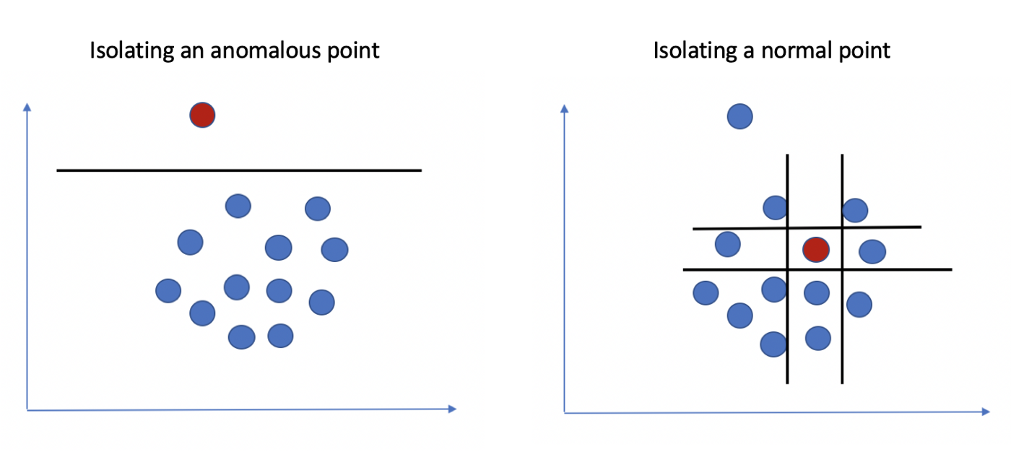
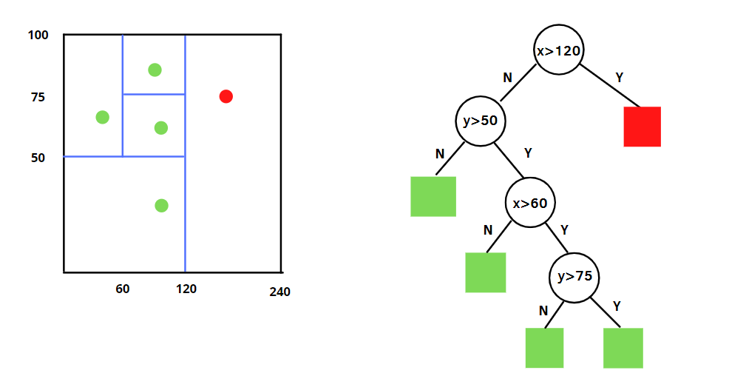
Isolation Forest
Randomly split a feature in the data to separate normal instances and anomalous instances
The idea is that an anomaly is more difficult to isolate (i.e., takes more splits), so, the number of splits for an instance to be totally isolated is used to predict whether it is anomalous

Slide 9
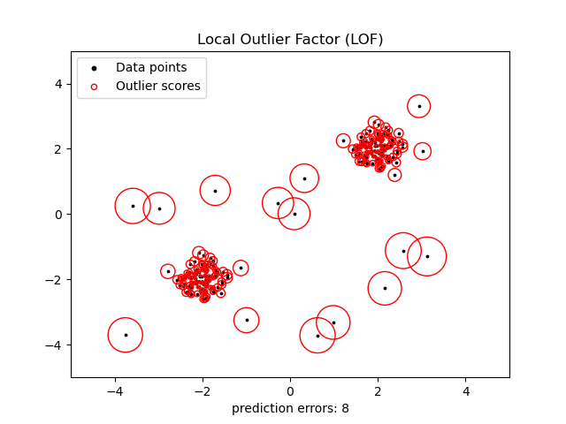
Local Outlier Factor
LOF calculates the local density deviation of each instance with respect to its neighbors (i.e., instances that are close enough to the given one) to evaluate whether that instance is an outliers
Roughly speaking, this means if an instances have more neighbors that are close, it is less likely to be an anomaly
And if an instance only have very far neighbors, it tends to be an anomaly

Slide 10
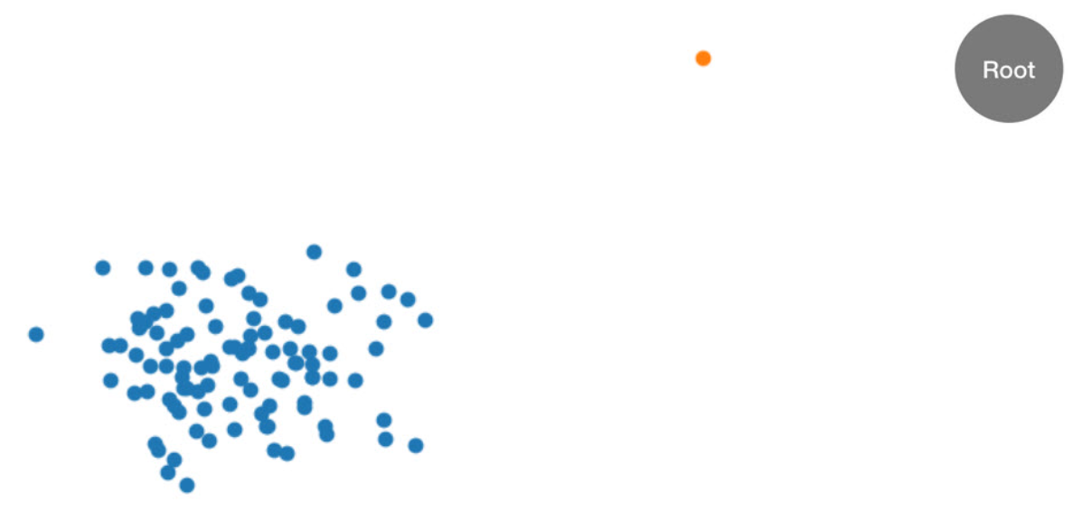
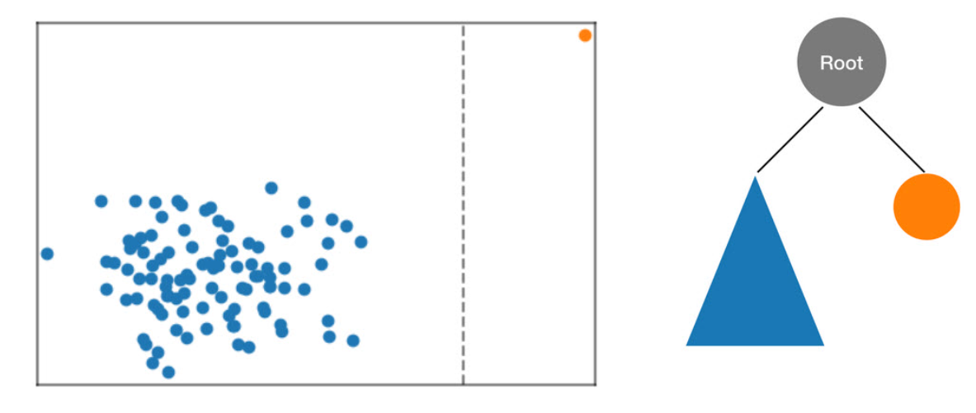
AWS Random Cut Forest
AWS model for anomaly detection
Fairly similar to Isolation Forest:
Uses tree split to separate regular and anomalous instances
Multiple trees are trained on different portions of the data
At prediction, the trees all make decision then vote whether an instance is anomalous or not

Slide 11
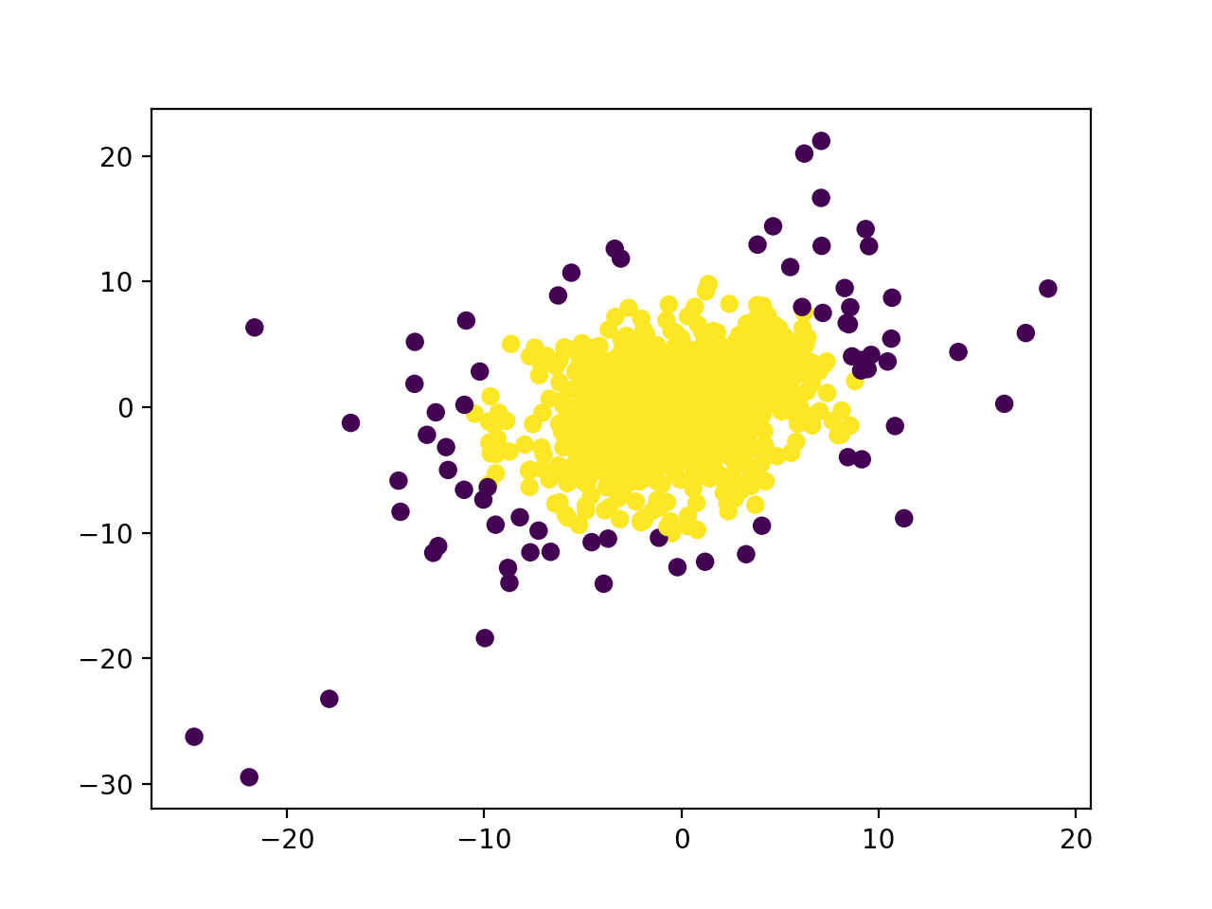
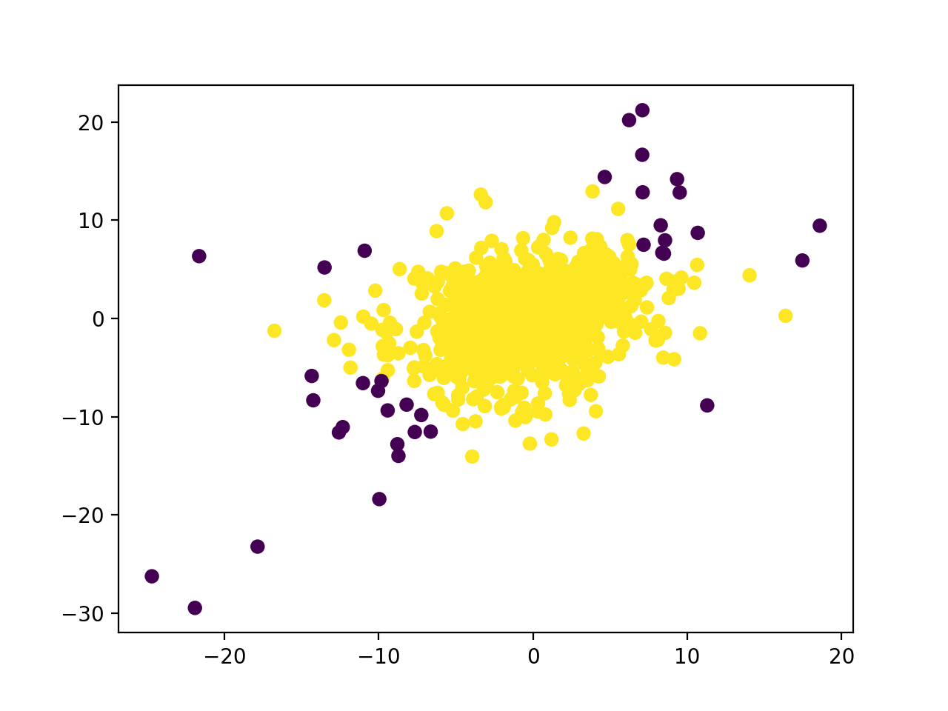
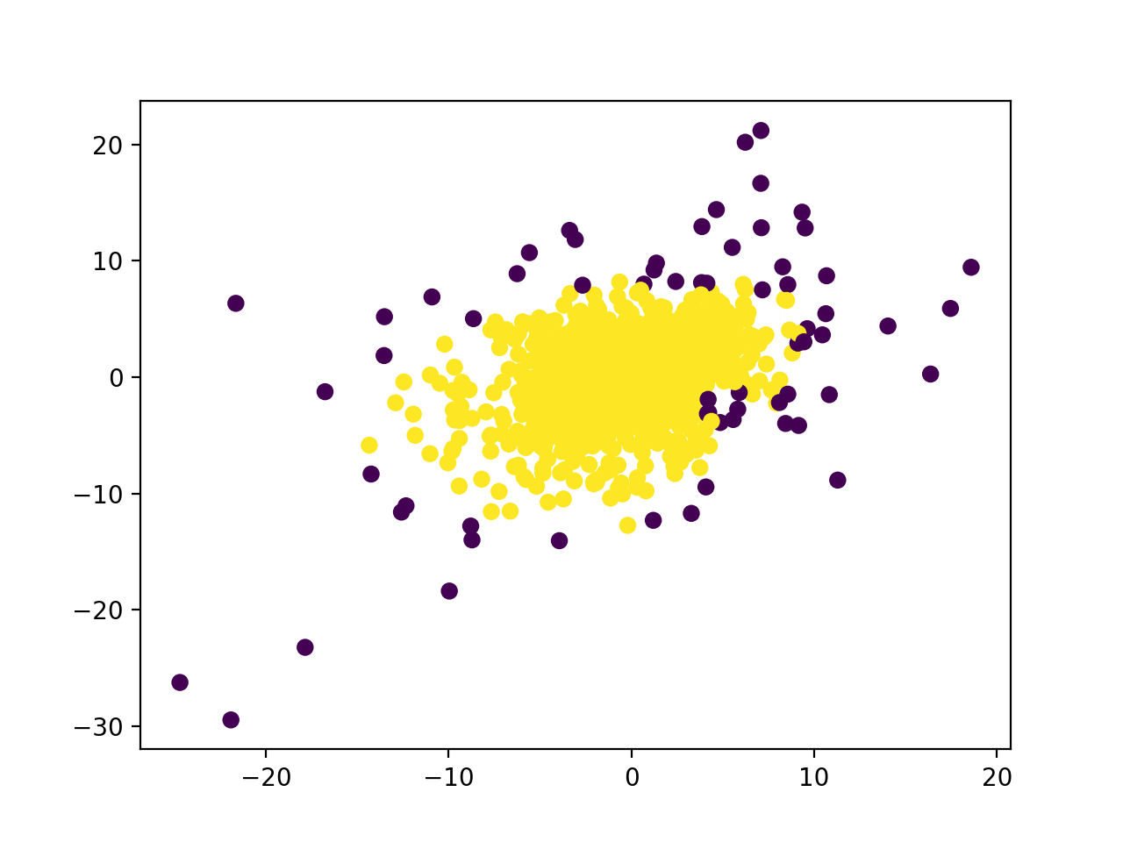
Tuning Anomaly Detection Model
Anomaly detection models are more challenged to tune because of the lack of labels (targets)
Depends on the data, we have to decide a suitable evaluation measurement that, sometimes, is not a common one. In other words, it is customized to the given data
This also means anomaly detection models are difficult to compare, since there are no ground truths. Which one among the three below is the best?
OC-SVM
IF
LOF

Slide 12
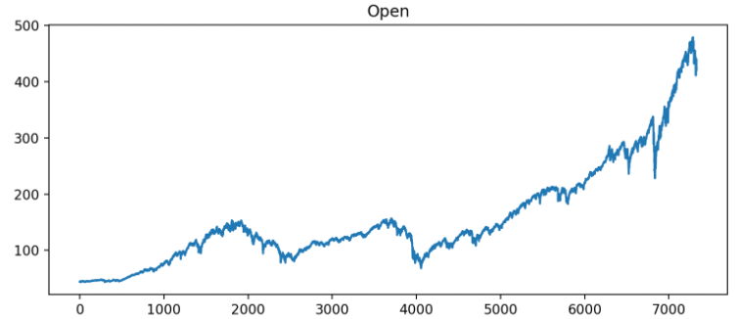
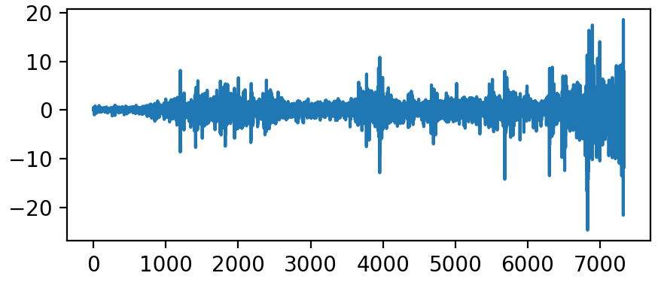
Differencing in Time Series
Data like stock data is called time series data – each instance represents one time point throughout a period, and the instances have a temporal correlation
Time series data that has trends (like stock data) in which closer data points are more correlated are not ideal to model – they may cause troubles for some models to learn
We usually handle this by difference the data – instead of using the data at each time point, we use the differences at each pair of time points
Day | Price | Price Difference
3/7/2022 | 104 | ---
3/8/2022 | 105 | 1
3/9/2022 | 107 | 2
3/10/2022 | 103 | -4
3/11/2022 | 102 | -1

Slide 13


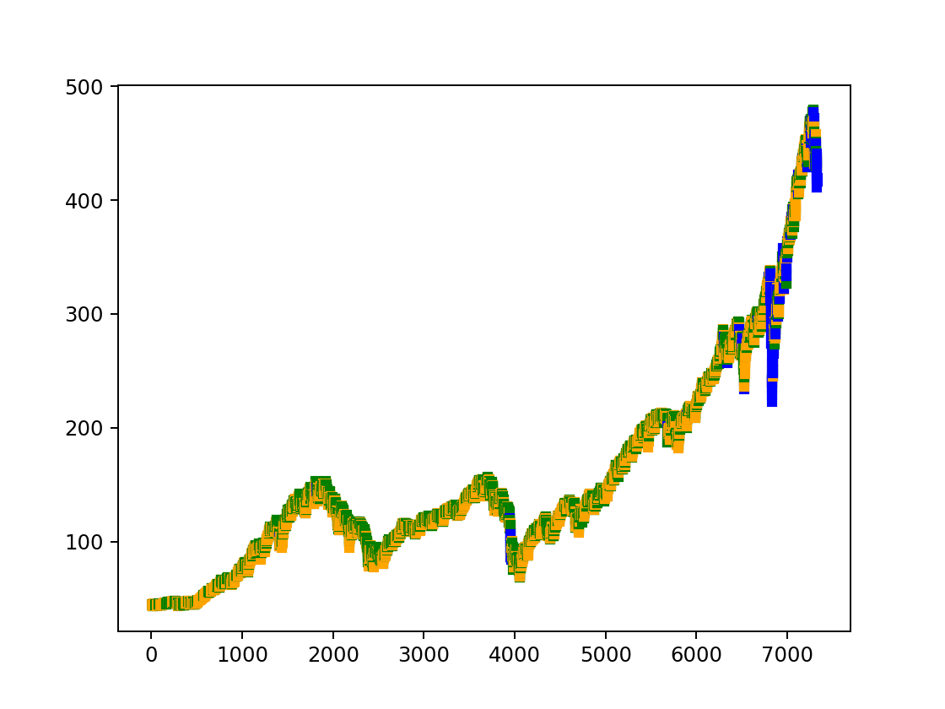
Anomalies in Differenced Data
After differencing, the models have more agreements on which dates are anomalies
OC-SVM
IF
LOF
RCF

Slide 14
Additional Reading
One-Class Support Vector Machine
https://scikit-learn.org/stable/modules/generated/sklearn.svm.OneClassSVM.html
Isolation Forest
https://scikit-learn.org/stable/modules/generated/sklearn.ensemble.IsolationForest.html
Local Outlier Factor
https://scikit-learn.org/stable/modules/generated/sklearn.neighbors.LocalOutlierFactor.html
AWS Random Cut Forest
https://docs.aws.amazon.com/sagemaker/latest/dg/randomcutforest.html

